Slide 1
Control Board to Accelerometer Cable

Slide 2
Materials

Slide 3
Tools

Slide 4
D sub Crimp Tool

Slide 5
Measure out and cut 20 inches of yellow, orange, green, violet, and black 28 awg wire.

Slide 6
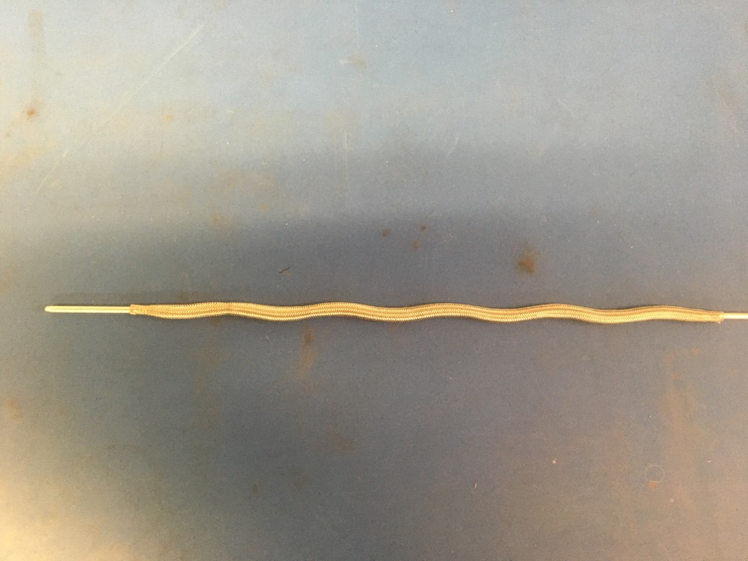
Measure out 13.5 inches of the 1/8th metal braid. Expand it using the metal rod.

Slide 7
Trim ends to 1.25in long

